Slide 1
Articles

Slide 2
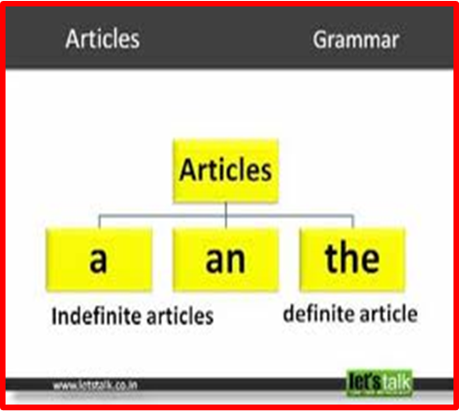
The is used to refer to specific or particular nouns.
It tells definitely which item we are talking about.
A/an is used to modify non-specific or non-particular nouns.
A is used before any consonant.
An is ued before any vowel sound.

Slide 3
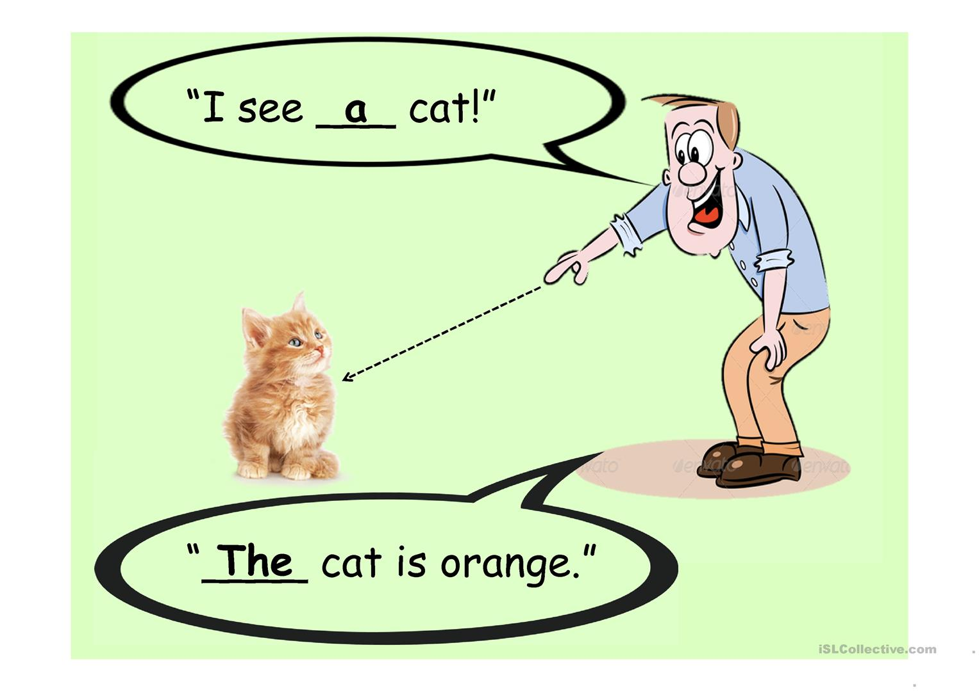
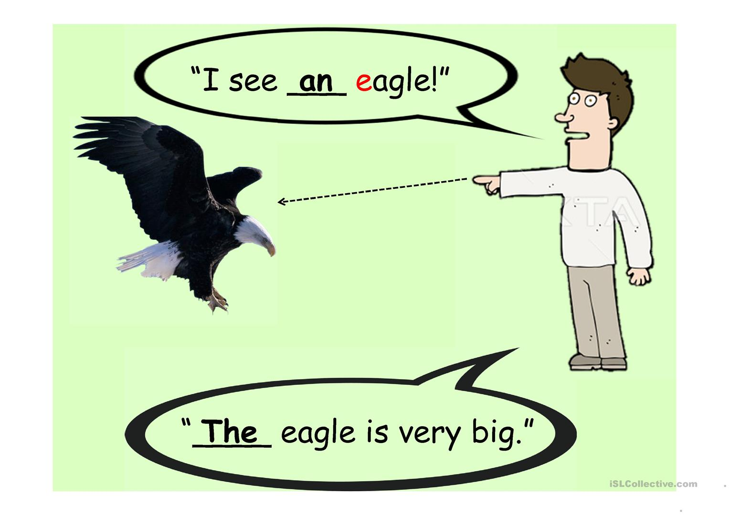

Slide 4
“An “ is used
Before a word beginning with a vowel.
(Eg.) an idiot, an apple
Or a vowel sound
(Eg.) an honor, an hour, an honest man

Slide 5
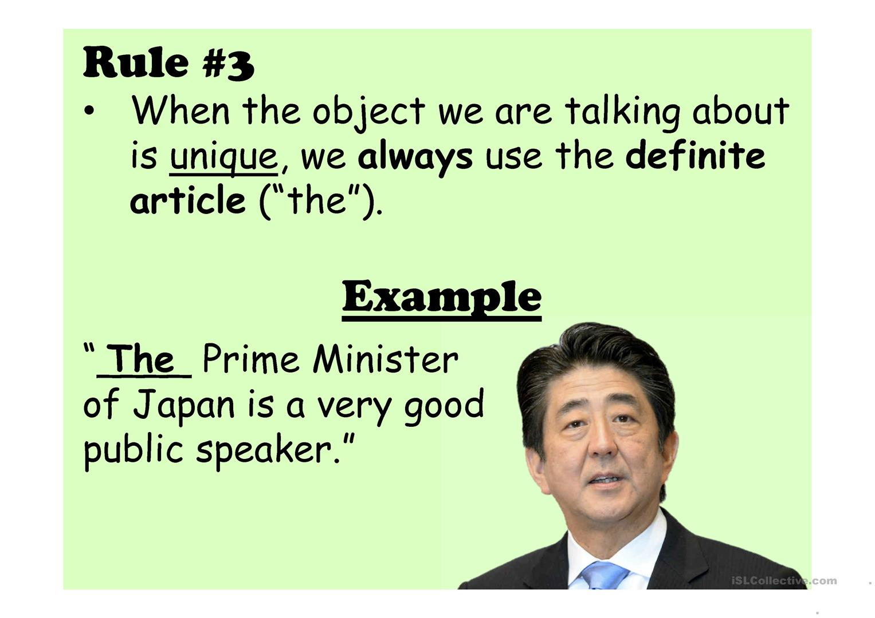
‘the’ is used
1. Before unique objects
(Eg) the sun, the sky, the moon
2. Before the names of mountains, rivers, oceans, deserts etc.
(Eg) the Ganges, The Sahara, the Pacific
3. Before the names of books
(Eg) the Bible, the Ramayana, the Quran
4. Before the superlative degree
(Eg) the best, the tallest

Slide 6
5. Before musical instruments
(Eg) the flute, the violin
6. Before an adjective to denote a whole class
(Eg) the old, the rich, the poor
7. Before ordinal numbers
(Eg) the first, the ninth
8. Before proper names 9pluracl) of people of nations
(Eg) the French, The Indians
9. Abbreviations use ‘the’
(Eg ) The Un, The USA, The IMF

Slide 7
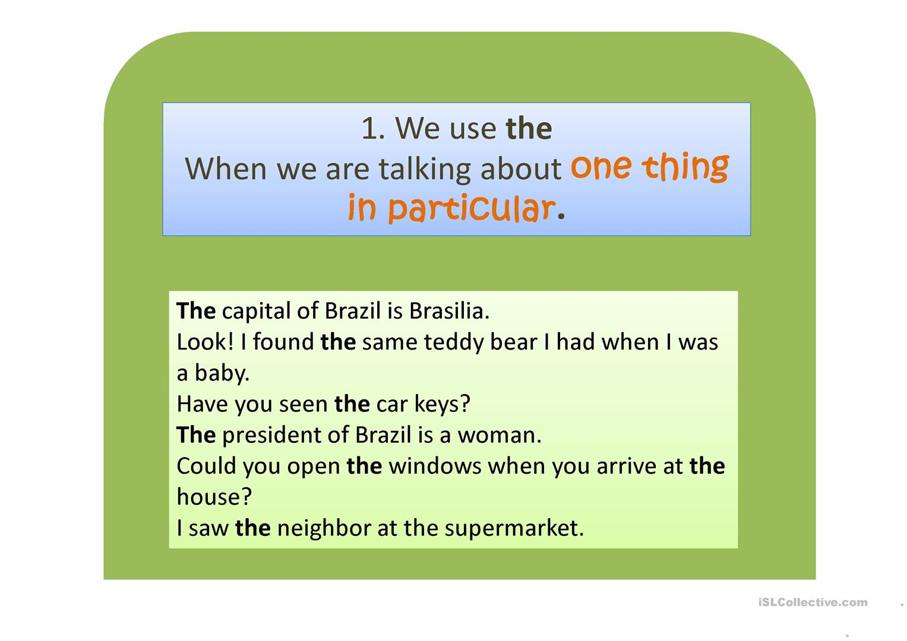

Slide 8
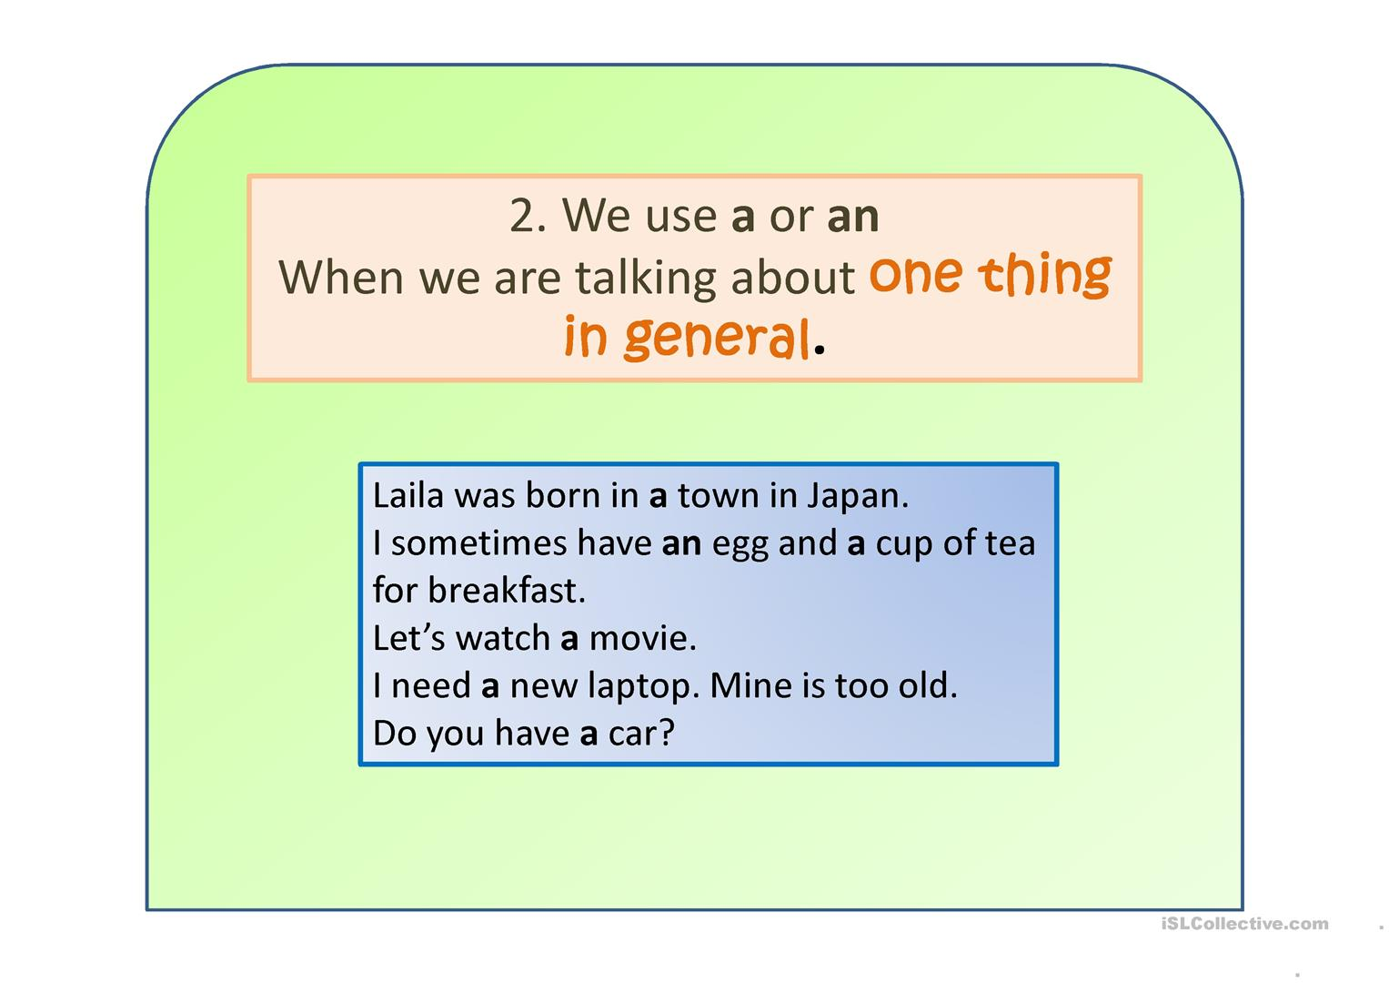

Slide 9
Omission of articles
Before the names of relations(father, uncle, sister)
Before the names of material(gold, silver, diamond)
Before proper noun (Lotus, Chennai, Priya)
Before abstract nouns (honesty, wisdom, truth)
Before language (Tamil, Hindi, English)

Slide 10
Exercise
1. Sri Lanka is _____ island.
2. She gave Sita _____ one rupee note.
3. Maya wore _____ red color saree.
4. He is ____ honorable man.
5. He met with _____ accident on his way home.
6. _____ Ganges is _____ holy river.
7. He worked efficiently as _______ M.L.A.
8. ______ Bible is ______ Sacred book of Christens.
9. Heaven is ______ happiest place.
10. Buying ____ Umbrella is not urgent.

Slide 11
11. _____ Sahara is ____ biggest desert in _____ world.
12. Mani bought ______ Car.
13. We went to ____ temple and saw ____ elephant eating bananas.
14. Sekar is ___ Advocate who is working in _____USA.
15. ____ Representative from Australia is _____ excellent speaker.

Slide 12
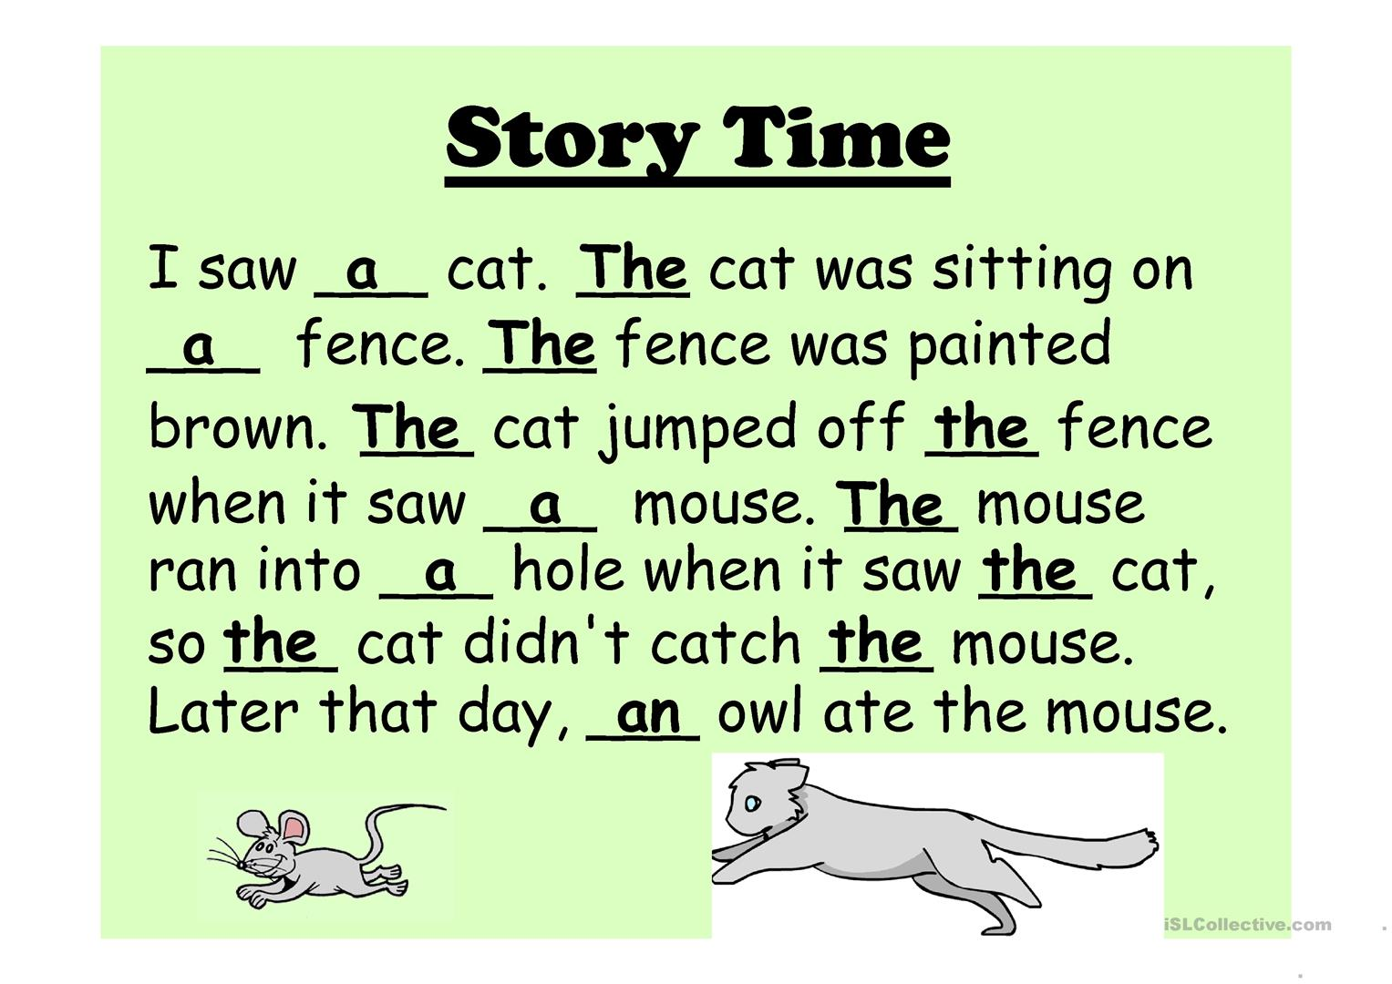

Slide 13
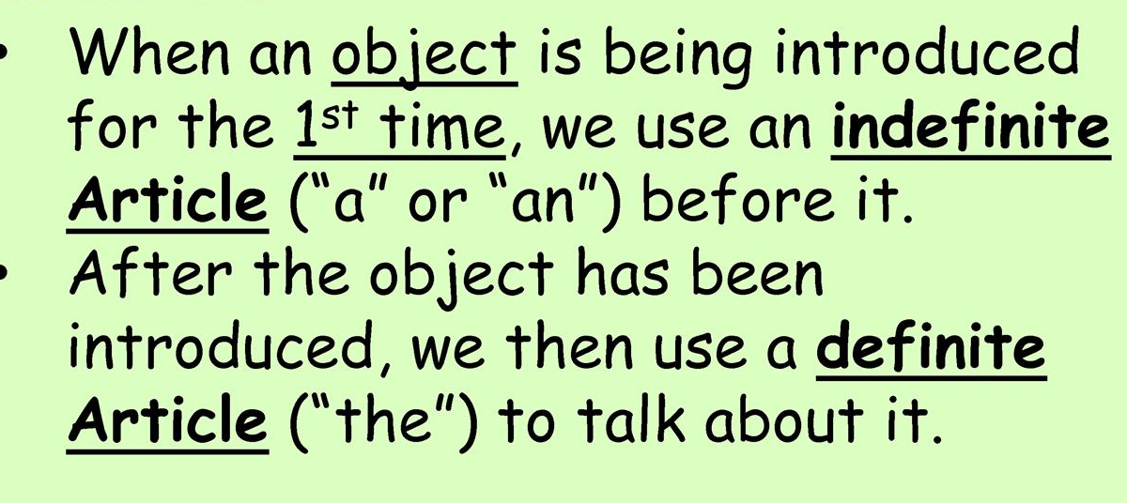
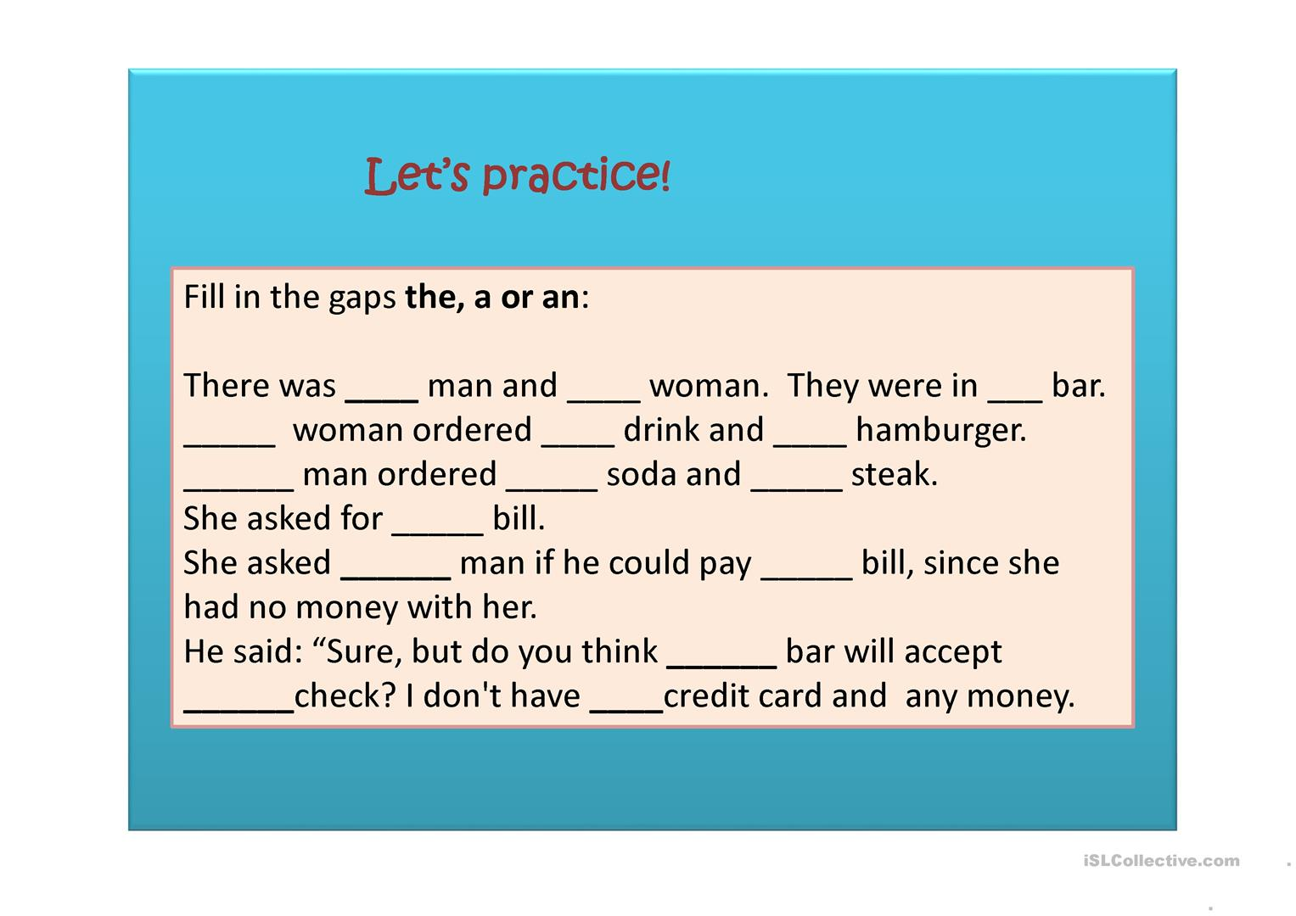

Slide 14
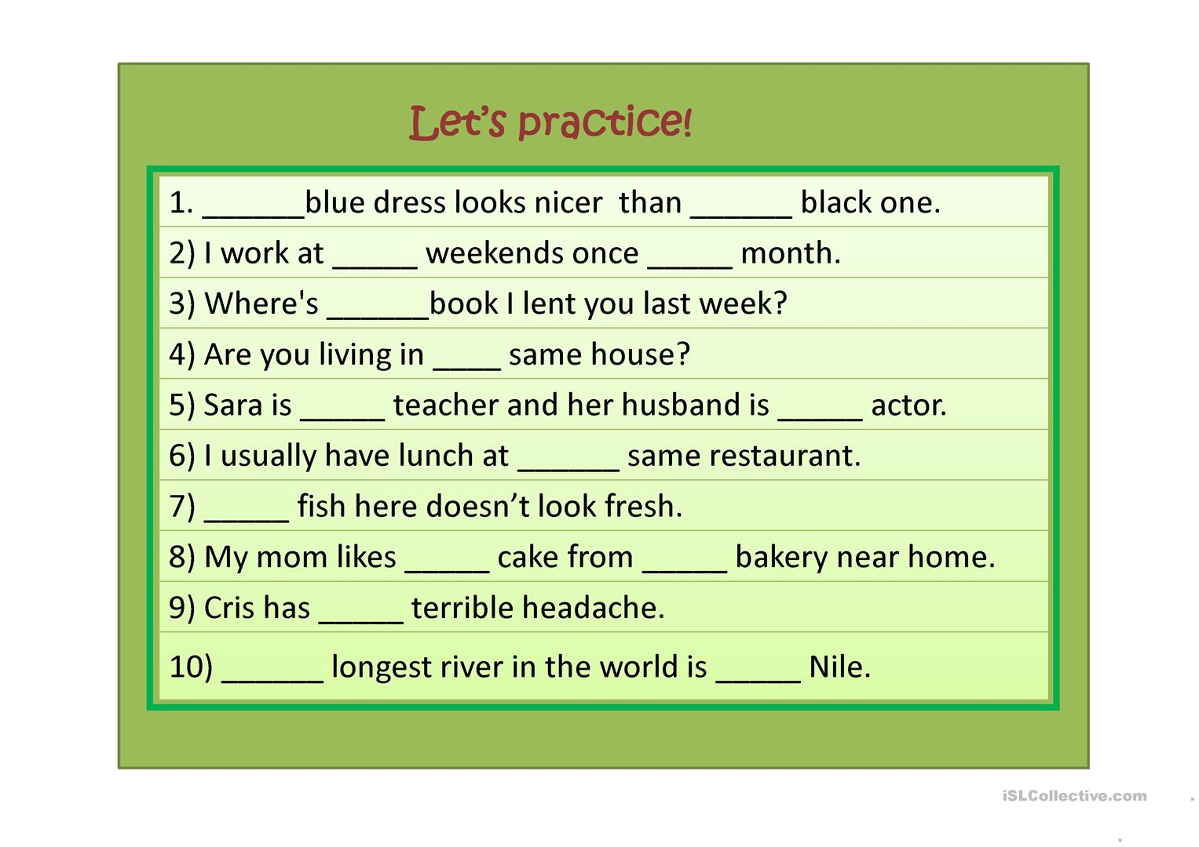

Slide 15

The end

